Slide 1
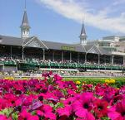
THE KENTUCKY DERBY
The Kentucky Derby is the most famous horse race in the world. The race takes place the first Saturday in May at Churchill Downs in Louisville, Kentucky. Many famous people, politicians, and people from all around the world visit Kentucky for the Derby.

Slide 2


History
The first Kentucky Derby was held on May 17, 1875, and was won by Aristides. Oliver Lewis, a black jockey, was the rider. Admission to the first Derby was only 50 cents.

Slide 3

THE RACE
The horses race for 1 ¼ miles which takes about 2 minutes.
The Kentucky Derby is sometimes called the “most exciting two minutes in sports”.

Slide 4
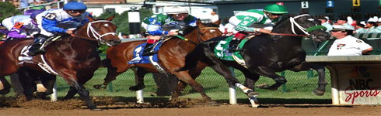
THE RACE
All horses that run in the Derby are 3 year old horses. Most horses in the Kentucky Derby are colts (young male horses), but fillies (young female horses) do sometimes run. Only three fillies have won. Each colt must carry 126 pounds. Each filly must carry 121 pounds.

Slide 5
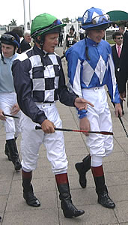
JOCKEYS
Each jockey weighs around 110 pounds. Their equipment includes a saddle, whip, boots, safety helmet, goggles, and silks. Each owner has a special silk design.

Slide 6
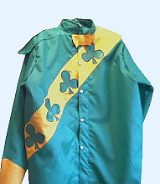
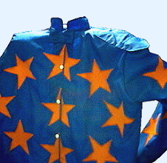
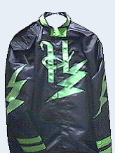
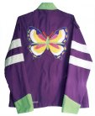
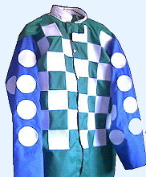
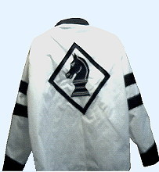
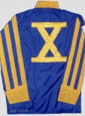
Jockey Silks

Slide 7
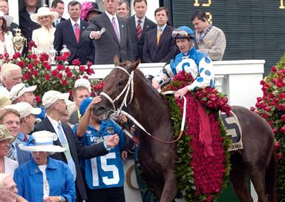
RUN FOR THE ROSES
The winning horse of the Kentucky Derby receives a garland of red roses, a “purse”, and a solid gold trophy worth $100,000.

Slide 8
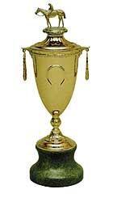
TROPHY
Since 1975 the trophy has been created by New England Sterling located in North Attleboro, Mass. The trophy, which is topped by an 18-karat gold horse and rider, includes horseshoe shaped handles, is 22 inches tall and weighs 56 ounces, excluding its jade base. The entire trophy is handcrafted with the exception of the horse and rider that are both cast from a mold.

Slide 9
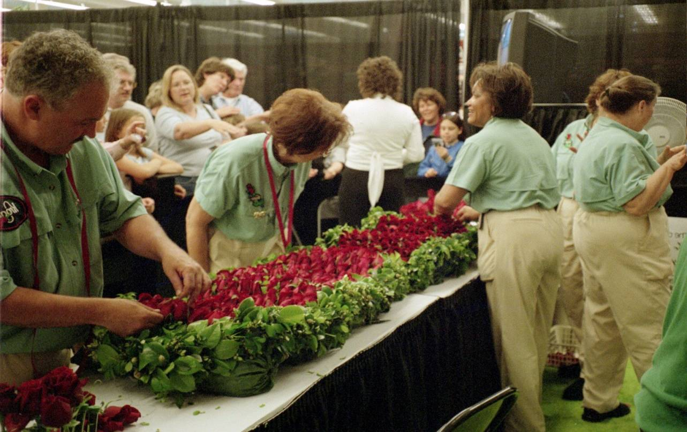
Florists from Kroger work on the garland of roses on Derby Eve. The public is invited to watch. Each year, a garland of 554 red roses is sewn into a green satin backing with the seal of the Commonwealth on one end and the twin spires and number of the running on the other. Each garland is also adorned with a "Crown" of roses, green fern and ribbon. The "Crown", a single rose pointing upward in the center of the garland, symbolizes the struggle and heart necessary to reach the winners' circle.
GARLAND OF ROSES

Slide 10

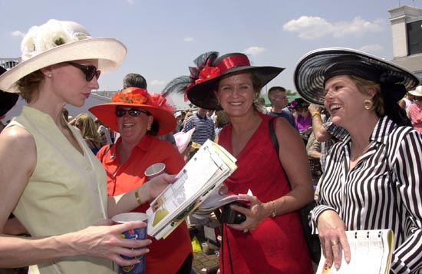
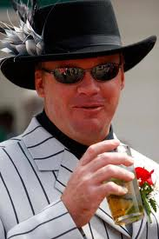
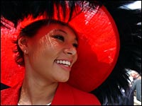
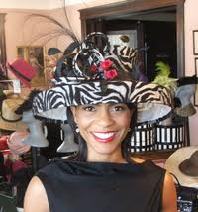
Derby Hats and Fashion

Slide 11
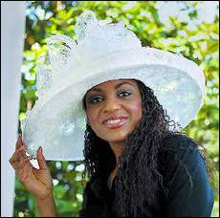
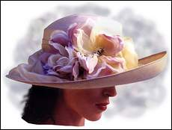
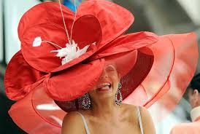


More Hats

Slide 12
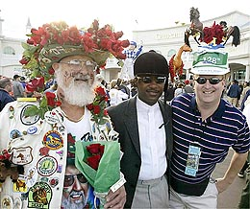
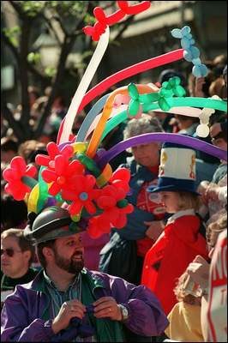
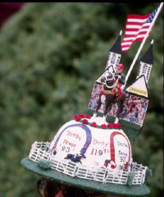
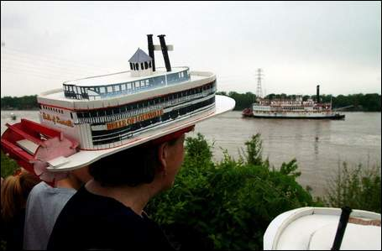
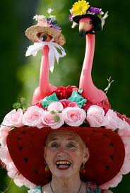
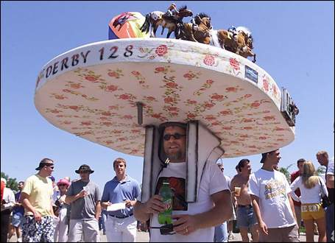
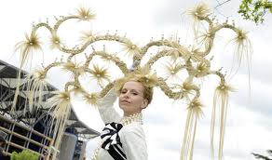
AND EVEN WILDER HATS!

Slide 13
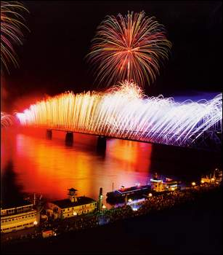
DERBY FESTIVAL
THUNDER OVER LOUISVILLE is a fireworks display over the Ohio River that begins the Kentucky Derby Festival. Many activities are planned for the two weeks prior to the Kentucky Derby. Many are races, too!

Slide 14
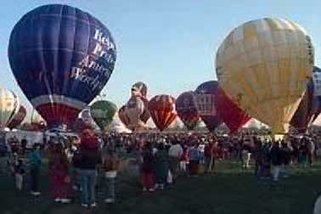
The Great Balloon Race
The hot air balloon race starts at the Kentucky State Fairgrounds in Louisville. Balloons fly to a spot and drop a sack of bluegrass seed on a target. The closest one wins the race.

Slide 15
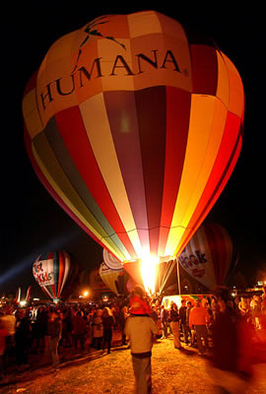
BALLOON GLOW
People can go to the fairgrounds and see the balloons lit up the night before the race.

Slide 16
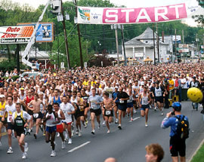
The mini-marathon is a 13 mile race held the Saturday before the derby.
MINIMARATHON

Slide 17
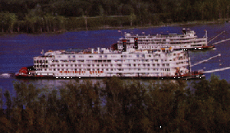
THE GREAT
STEAMBOAT RACE
The Belle of Louisville, the Belle of Cincinnati, and the American Queen will race up and down the Ohio River. The crews of each boat also compete in other events. The winner of the steamboat race wins silver-plated antlers.

Slide 18
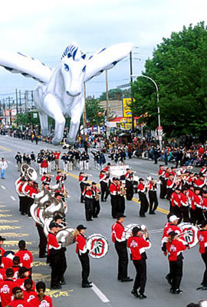
THE PEGASUS PARADE
In 1956, the Pegasus Parade was the first event held by the Kentucky Derby Festival. The parade is full of bright and colorful floats. In addition, there are bands, beautiful horses, giant inflatable balloons, clowns and celebrities joining the parade.

Slide 19
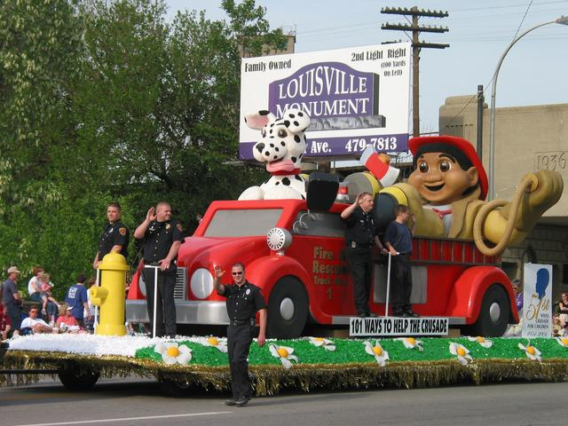
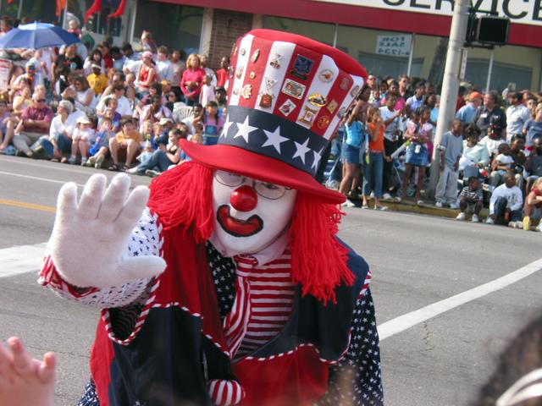
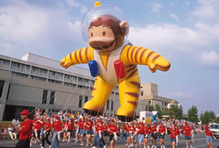
PEGASUS PARADE

Slide 20
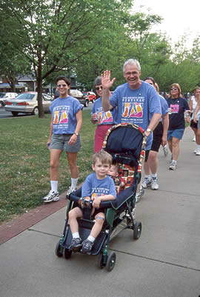
RAMBLE FOR THE ROSES
Most years, Ms. Whitfield participates in the Ramble for the Roses which is a non-competitive 5-mile-walk.

Slide 21
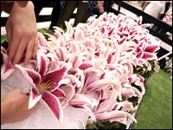
KENTUCKY OAKS
On the day before the derby, the Kentucky Oaks race is held at Churchill Downs. This race is only for fillies (girl horses). The winner of the Kentucky Oaks wins a garland of lilies instead of roses.

Slide 22
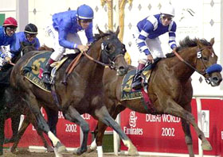
139th Derby
May 5, 2013
General admission tickets-$40
Grandstand or Millionaire’s Row tickets--officially sold out, but can be purchased through brokers. Good luck!!

Slide 23
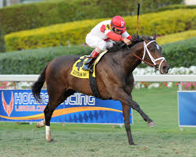
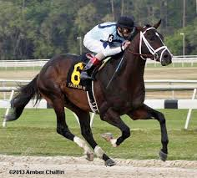
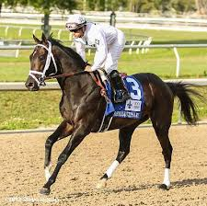
WHO WILL WEAR THE GARLAND OF ROSES THIS YEAR?
Charming Kitten?
Verrazano?
Revolutionary?

Slide 24
Credits
Information and pictures taken from churchilldowns.com; whas11.com; courierjournal.com; racing.bloodhorse.com; kdf.org; youtube.com; derbymuseum.org; z6mag.com; hatsrcool.com; sportsillustrated.cnn.com; horseracing.about.com and louisville.about.com.
Presentation created by Tracy Taylor and adapted by Becky Stephens, Darlah Carman, Allison Doutaz, and Suzannah Whitfield.

Slide 25
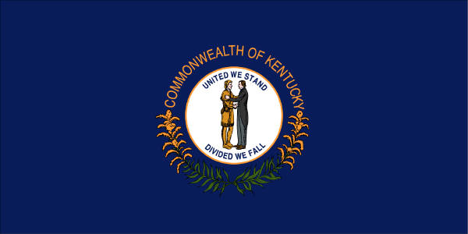
My Old Kentucky Home

